Slide 1
Sona College of Technology Department of Computer Science and Engineering

Slide 2
TEXTURE ANALYSIS AND DISEASE PREDICTION IN NAILS USING MACHINE LEARNING
Team Members:
1. Rithika.R (1919102122)
2. Pooja.S (1919102106)
3. Rohinth.S (1919102125)
Name of the Supervisor: Dr. S.Vidhushavarshini
Assistant Professor/CSE

Slide 3
Introduction
In an early stage of diagnosis, this experiment suggests utilizing nail color to forecast disorders. Our project's primary goal is to study the illness without endangering people
In the older, more conventional method of disease detection, doctors would look at the patients' nails and make a diagnosis. Patients' nails can be examined to help diagnose a variety of illnesses
Our suggested solution is entirely computer-based, it can be quite helpful in resolving this problem. The suggested system's input is a picture of a nail
The technology will analyze the image of the nail and extract its attributes to determine the disease. Our suggested technique leverages variations in nail color to identify sickness

Slide 4
Objective
The modern approach to healthcare is to prevent the disease with early intervention rather than go for treatment after diagnosis
The main objective of our project is to predict many diseases by observing the color of human nails
The types of Diseases can be identified based on the color and texture of the nails and will be classified and processed by a convolutional neural network
The disease can be identified and diagnosed in the early stage

Slide 5
Proposed work
A bunch of strategies or standards or rules for directing the cycle is called System
The Proposed Model has four significant stages
Input to the model: Filtering the picture containing fingers, rear of palm locale in fitting splendor
Extraction of the cropped Nail region from the entire Palm: Applying division strategy on the picture to separate the nail from the whole picture
Analysis of the Nail region, Color, and Texture: The fragmented nail picture is presently being handled based on variety and surface and we will decide the well-being of the nail by contrasting the fragmented picture and the dataset present
Disease Prediction using Knowledge base: The outcome will be produced on the premise of investigation and the illness would be anticipated if present

Slide 6
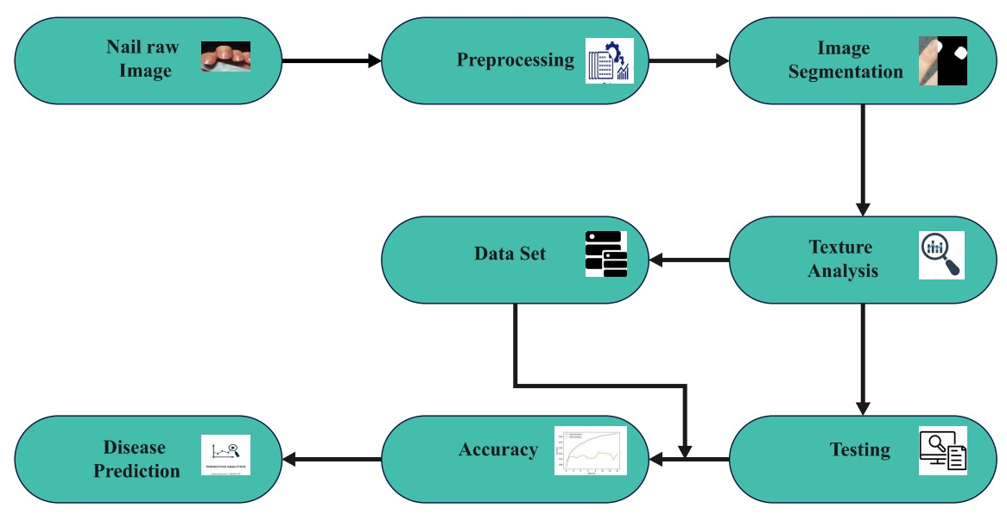
Architecture

Slide 7
Modules
Collecting data set
Preprocessing the data
Code implementation
Testing with the data set
Finding the accuracy
Disease prediction

Slide 8
Algorithms
Preprocessing
Image Segmentation(Graph cut Technique)
Segmentation
[BW,MASKEDIMAGE] = segmentImage(RGB)
Feature Selection
E = rescale(entropyfilt(MASKEDIMAGE)):
Classification
CNN Algorithm

Slide 9
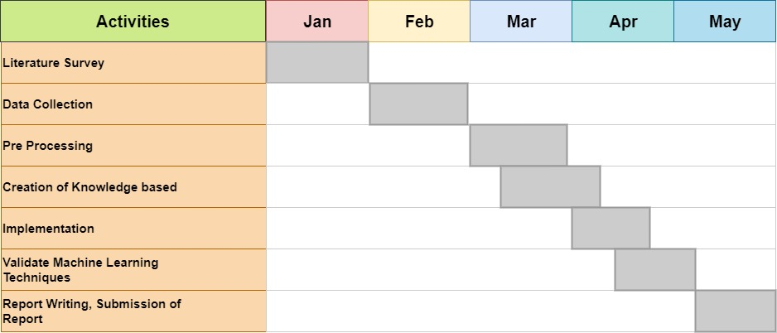
Gantt Chart

Slide 10
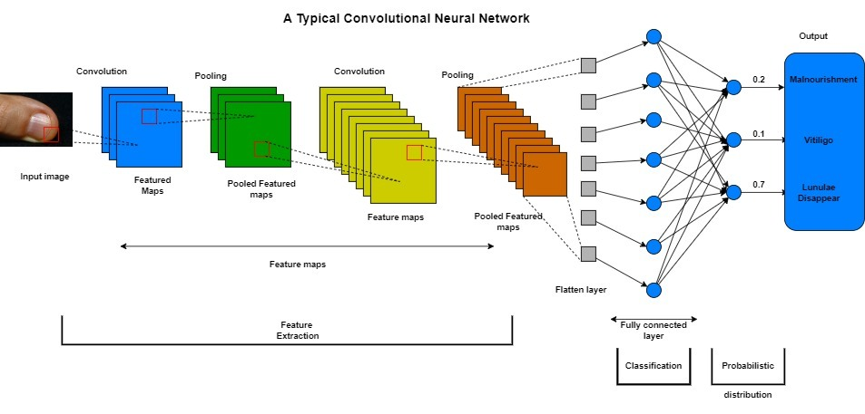
Expected Outcome

Slide 11
Sample Code
clc
close all
warning off
RGB=imread('nail.jpeg’);
subplot(1,3,1);
imshow(RGB);
title('Original')[BW,MASKEDIMAGE] = segmentImage(RGB)
subplot(1,3,2);
imshow(MASKEDIMAGE);
title('Segmented')subplot(1,3,3);
E = rescale(entropyfilt(MASKEDIMAGE));
imshow(E);
title('Texture Segmentation');

Slide 12
Generated segmentation function
function [BW,maskedImage] = segmentImage(RGB)
%segmentImage Segment image using auto-generated code from Image Segmenter app
% [BW,MASKEDIMAGE] = segmentImage(RGB) segments image RGB using
% auto-generated code from the Image Segmenter app. The final segmentation
% is returned in BW, and a masked image is returned in MASKEDIMAGE.
% Auto-generated by imageSegmenter app on 02-Mar-2023%----------------------------------------------------

Slide 13
Generated segmentation function
% Convert RGB image into L*a*b* color space.X = rgb2lab(RGB);% Graph cutforegroundInd = [211478 211485 211495 211502 213942 213988 215655 215662 217234 217326 219817 223002 223136 227282 229736 229738 229741 229769 231393 233052 233083 235563 238849 241354 242988 242997 243011 244659 250455 254594 258733 266174 273297 273618 281884 297215 299245 310811 312058 322377 332294 349635 353301 361192 370619 372749 380179 387942 392559 403614 411536 415164 430012 442384 457234 461861 463009 471259 480334 500137 511687 530667 544696 569458 569901 581013 590917 597102 604949 622642 631703 635507 641582 647345 651213 651463 655581 657224 ];backgroundInd = [6949 6974 8566 8659 8676 10349 12634 14252 14273 14296 14324 14355 15867 16162 19961 20343 21665 21850 24506 25715 28234 29877 30142 33949 33984 34286 35620 35624 37246 37265 37602 39733 39735 41381 41395 43019 43024 43061 43403 45496 46103 47146 47149 47151 47552 48806 49220 49265 49291 49328 49356 49380 49406 49415 49424 51269 51271 51285 52942 54602 57044 57079 60344 60388 60393 60449 62812 62877 64471 64537 66121 66199 68596 68692 70251 72016 74556 74634 76031 80127 80303 84658 85973 87627 90023 90117 93428 93541 97570 101821 103220 103481 105023 107509 107615 107631 109406 109424 109441 109445 109455 109467 109481 110807 110995 111016 113303 113627 114984 115000 115009 115014 115021 115028 115038 116697 119184 119202 119217 119228 119240 119256 119299 119313 119406 121092 125231 126902 129372 132688 136349 140950 144262 144271 147888 148403 150044 152545 154202 157909 158334 161608 164113 165428 169860 170967 172675 172886 175638 177027 179266 179765 183065 185624 186686 186965 188840 191106 192398 192965 196574 197092 199731 202689 205640 208481 209711 214420 215924 221711 225374 225421 229977 235762 241040 241544 242624 246855 250628 252623 253106 258297 258356 258885 261691 264756 267979 271495 271581 272120 275674 283696 285517 285597 287863 291342 291367 291967 294592 297756 299418 304560 305207 308659 310267 310994 314458 315128 320870 321857 326008 334075 341652 341678 343263 343977 349103 353200 359003 359650 361300 362273 362950 364710 365425 365432 366428 368723 372848 372859 376973 377948 377976 386158 392645 393620 394314 397774 401744 403478 409293 411611 411646 420803 426578 426618 427321 428228 437221 438168 444602 451366 451394 454567 460321 460331 463570 463619 468688 471871 473467 473484 473502 477618 480911 483365 485069 487502 490790 490799 490804 492613 499038 499040 500062 502389 506458 507463 510588 513937 517996 518010 519677 523162 523767 525435 527889 527957 530563 531184 537782 541082 543583 543627 544588 545205 545247 546855 549330 551008 555105 557788 558405 560920 560945 562532 571813 572437 572467 574108 579864 580891 581531 583989 584015 584031 585639 588114 589141 589764 591417 591431 591452 593892 593894 594932 595556 595572 597194 597210 597217 599043 599671 599681 599688 599690 601326 602978 602981 602983 604820 612248 618025 618032 622152 627930 627932 ];

Slide 14
Generated segmentation function
L = superpixels(X,3400,'IsInputLab',true);
% Convert L*a*b* range to [0 1]scaledX = prepLab(X);BW = lazysnapping(scaledX,L,foregroundInd,backgroundInd);
% Create masked image.maskedImage = RGB;maskedImage(repmat(~BW,[1 1 3])) = 0;endfunction out = prepLab(in)
% Convert L*a*b* image to range [0,1]out = in;out(:,:,1) = in(:,:,1) / 100;
% L range is [0 100].out(:,:,2) = (in(:,:,2) + 86.1827) / 184.4170;
% a* range is [-86.1827,98.2343].out(:,:,3) = (in(:,:,3) + 107.8602) / 202.3382;
% b* range is [-107.8602,94.4780].end

Slide 15
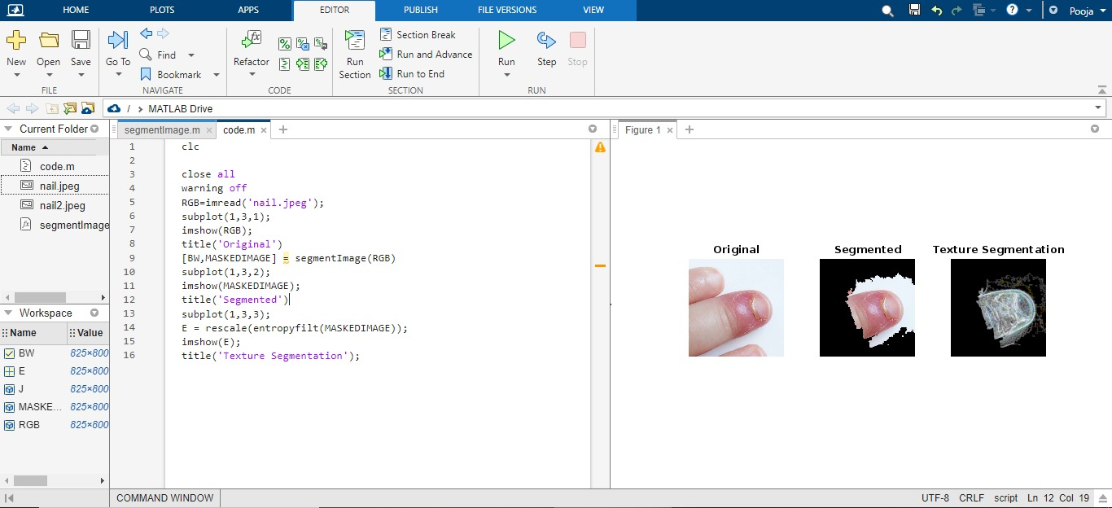
Output

Slide 16
References
[1] N. Bajpai, R. Alawadhi, A. Thakare, S. Avhad and S. Gandhat, Automated prediction system for various health conditions by analyzing human palms and nails using image matching technique, Int. J. Sci. Engin. (2019)
[2] Mente, Rajivkumar, and S. V. Marulkar. "A review: Fingernail images for disease detection." Int. J. Eng. Comput. Sci 6, no. 11 (2020): 22830-22835
[3] ] P. Hardik and D. Shah, The model of nail color analysis: An application of digital image processing, Int. J. Adv. Res. Comput. Sci. Software Engin.
[4] S. Hsiung Lee and C. Sing Yang, Fingernail analysis management system using microscopy sensor and blockchain technology, Int. J. Distrib. Sensor Networks .
[5] T.S. Indi and Y.A. Gunge, Early stage disease diagnosis system using human nail image processing, Int. J. Inf. Technol. Comput. Sci. 7 .

Slide 17
References
[6] H. A. Atabay, “Deep residual learning for tomato plant leaf disease identification”, Journal of Theoretical & Applied Information Technology, 2017.
[7] S. Zhang, W. Huang, and C. Zhang, “Tree-channel convolutional neural networks for vegetable leaf disease recognition”, Cognitive Systems Research, 2018.
[8] ] D. P. Hughes and M. Salathe, “An open access repository of images on ´ plant health to enable the development of mobile disease diagnostics”, arXiv.2015.
[9] Y. LeCun, Y. Bengio, and G. Hinton, “Deep Learning”, Nature, 2015.
[10] V. Tumen, ¨ O. F. S ¨ oylemez and B. Ergen, “Facial emotion recognition on ¨ a dataset using convolutional neural network”, 2017 International Artificial Intelligence and Data Processing Symposium (IDAP), November 2017.

